Slide 1
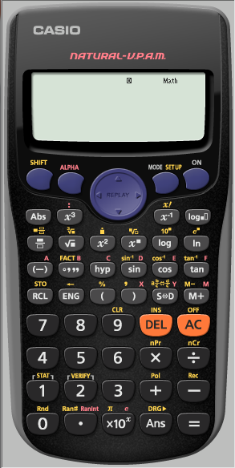
Finding the mean from a frequency table
E.g. the following table shows the mean height of 30 students in our class.
Find the mean height
We first need to make sure
the calculator is CLeaR of all
previous content
Height (x cm) | 130 - 140 | 140 – 150 | 150 – 160 | 160 – 170 | 170 – 180
Frequency | 5 | 7 | 8 | 6 | 4

Slide 2
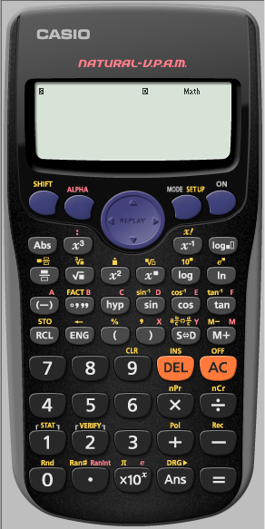
Height (x cm) | 130 - 140 | 140 – 150 | 150 – 160 | 160 – 170 | 170 – 180
Frequency | 5 | 7 | 8 | 6 | 4
We first need to make sure
the calculator is CLeaR of all
previous content

Slide 3
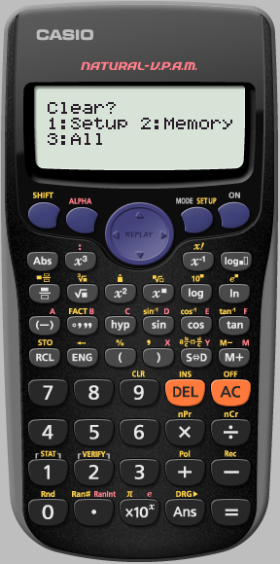
Height (x cm) | 130 - 140 | 140 – 150 | 150 – 160 | 160 – 170 | 170 – 180
Frequency | 5 | 7 | 8 | 6 | 4
We want to clear All

Slide 4
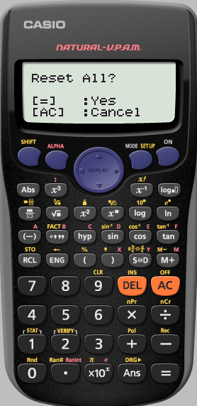
Height (x cm) | 130 - 140 | 140 – 150 | 150 – 160 | 160 – 170 | 170 – 180
Frequency | 5 | 7 | 8 | 6 | 4
Yes Reset all

Slide 5
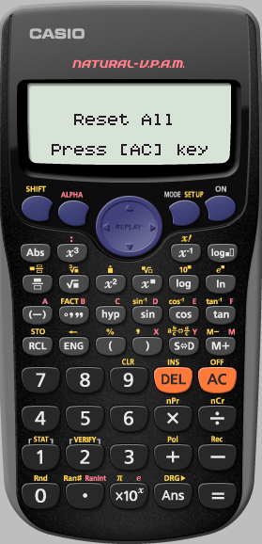
Height (x cm) | 130 - 140 | 140 – 150 | 150 – 160 | 160 – 170 | 170 – 180
Frequency | 5 | 7 | 8 | 6 | 4
We really do agree
AC

Slide 6
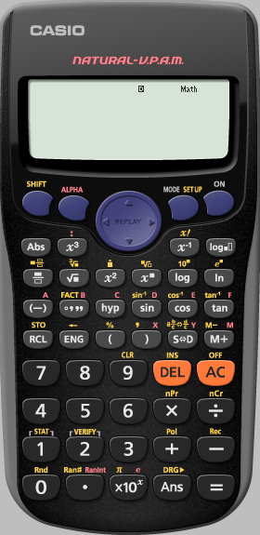
Height (x cm) | 130 - 140 | 140 – 150 | 150 – 160 | 160 – 170 | 170 – 180
Frequency | 5 | 7 | 8 | 6 | 4
We need to SET UP the
Calculator into STATS
to switch ON
the Frequency option

Slide 7
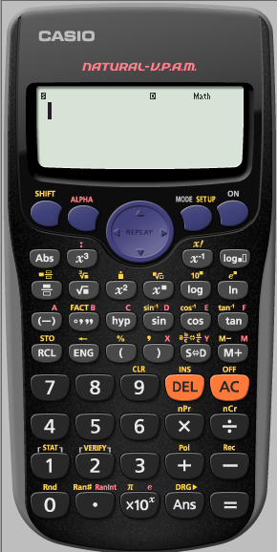
Height (x cm) | 130 - 140 | 140 – 150 | 150 – 160 | 160 – 170 | 170 – 180
Frequency | 5 | 7 | 8 | 6 | 4
We need to SET UP the
Calculator into STATS
to switch ON
the Frequency option

Slide 8
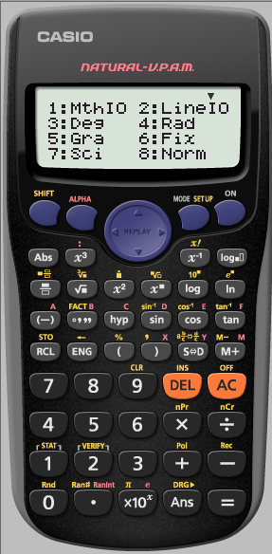
Height (x cm) | 130 - 140 | 140 – 150 | 150 – 160 | 160 – 170 | 170 – 180
Frequency | 5 | 7 | 8 | 6 | 4
We need to SET UP the
Calculator into STATS
to switch ON
the Frequency option

Slide 9
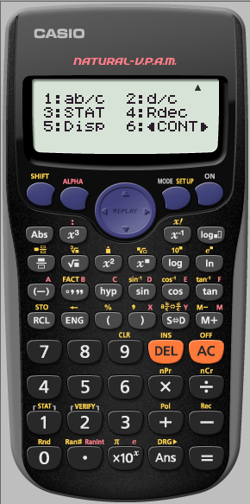
Height (x cm) | 130 - 140 | 140 – 150 | 150 – 160 | 160 – 170 | 170 – 180
Frequency | 5 | 7 | 8 | 6 | 4
We need to SET UP the
Calculator into STATS
to switch ON
the Frequency option

Slide 10
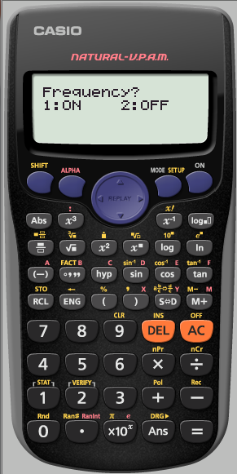
Height (x cm) | 130 - 140 | 140 – 150 | 150 – 160 | 160 – 170 | 170 – 180
Frequency | 5 | 7 | 8 | 6 | 4
We need to SET UP the
Calculator into STATS
to switch ON
the Frequency option

Slide 11
Height (x cm) | 130 - 140 | 140 – 150 | 150 – 160 | 160 – 170 | 170 – 180
Frequency | 5 | 7 | 8 | 6 | 4
We want the calculator
in STATS mode

Slide 12
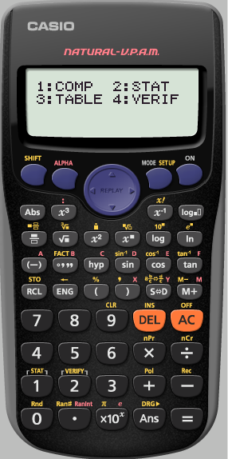
Height (x cm) | 130 - 140 | 140 – 150 | 150 – 160 | 160 – 170 | 170 – 180
Frequency | 5 | 7 | 8 | 6 | 4
We want the calculator
in STATS mode

Slide 13
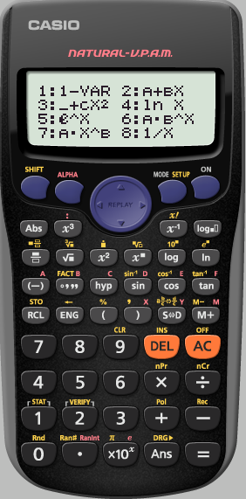
Height (x cm) | 130 - 140 | 140 – 150 | 150 – 160 | 160 – 170 | 170 – 180
Frequency | 5 | 7 | 8 | 6 | 4
We only have 1 variable

Slide 14
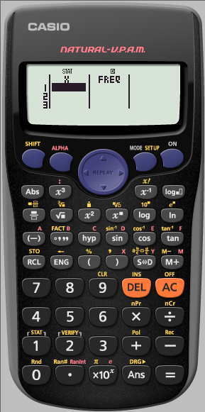
135 145 155 165 175
Height (x cm) | 130 - 140 | 140 – 150 | 150 – 160 | 160 – 170 | 170 – 180
Frequency | 5 | 7 | 8 | 6 | 4
We need to put in the
mid interval values
of the first row
Pressing
=
After each one

Slide 15
135 145 155 165 175
Height (x cm) | 130 - 140 | 140 – 150 | 150 – 160 | 160 – 170 | 170 – 180
Frequency | 5 | 7 | 8 | 6 | 4
We need to enter the
mid interval values
of the first row
Pressing
=
After each one

Slide 16
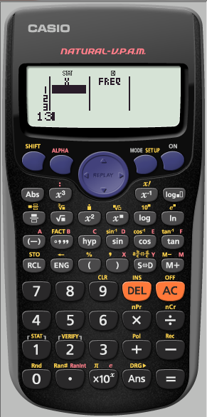
135 145 155 165 175
Height (x cm) | 130 - 140 | 140 – 150 | 150 – 160 | 160 – 170 | 170 – 180
Frequency | 5 | 7 | 8 | 6 | 4
We need to enter the
mid interval values
of the first row
Pressing
=
After each one

Slide 17
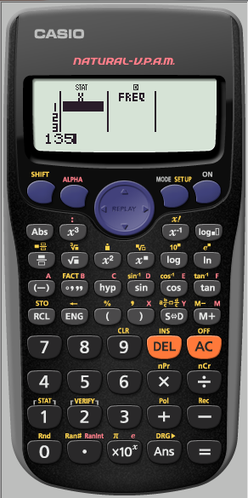
135 145 155 165 175
Height (x cm) | 130 - 140 | 140 – 150 | 150 – 160 | 160 – 170 | 170 – 180
Frequency | 5 | 7 | 8 | 6 | 4
We need to enter the
mid interval values
of the first row
Pressing
=
After each one

Slide 18
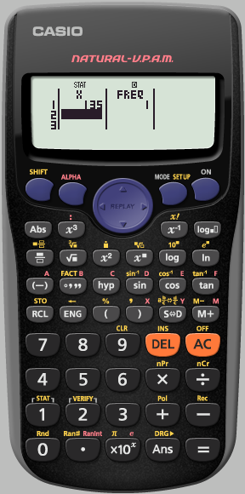
135 145 155 165 175
Height (x cm) | 130 - 140 | 140 – 150 | 150 – 160 | 160 – 170 | 170 – 180
Frequency | 5 | 7 | 8 | 6 | 4
We need enter the
mid interval values
of the first row
Pressing
=
After each one

Slide 19
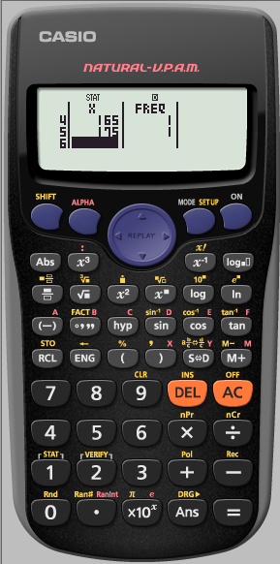
135 145 155 165 175
Height (x cm) | 130 - 140 | 140 – 150 | 150 – 160 | 160 – 170 | 170 – 180
Frequency | 5 | 7 | 8 | 6 | 4
Use the cursor
keys to enter
the data from
the second row
The down arrow takes
you to the top
of the column

Slide 20
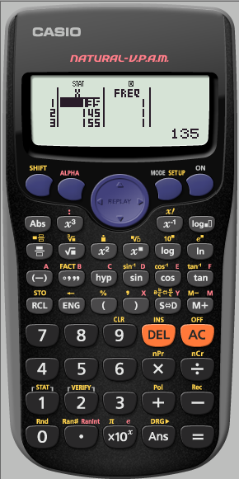
135 145 155 165 175
Height (x cm) | 130 - 140 | 140 – 150 | 150 – 160 | 160 – 170 | 170 – 180
Frequency | 5 | 7 | 8 | 6 | 4
Use the cursor
keys to enter
the data from
the second row
The right arrow takes
you to the top
of the next column

Slide 21
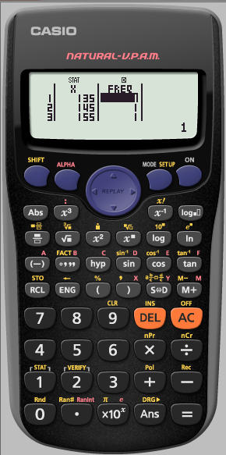
135 145 155 165 175
Height (x cm) | 130 - 140 | 140 – 150 | 150 – 160 | 160 – 170 | 170 – 180
Frequency | 5 | 7 | 8 | 6 | 4
We need to enter the
Frequencies
Pressing
=
After each one

Slide 22
135 145 155 165 175
Height (x cm) | 130 - 140 | 140 – 150 | 150 – 160 | 160 – 170 | 170 – 180
Frequency | 5 | 7 | 8 | 6 | 4
We need to enter the
Frequencies
Pressing
=
After each one

Slide 23
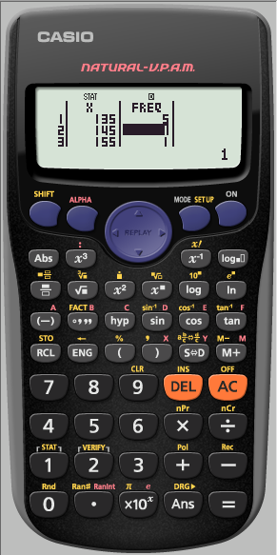
135 145 155 165 175
Height (x cm) | 130 - 140 | 140 – 150 | 150 – 160 | 160 – 170 | 170 – 180
Frequency | 5 | 7 | 8 | 6 | 4
We need to enter the
Frequencies
Pressing
=
After each one

Slide 24
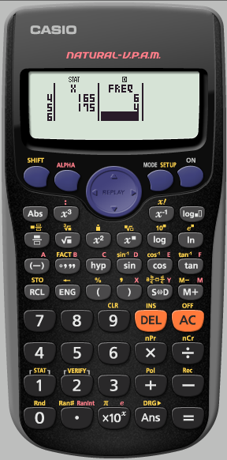
135 145 155 165 175
Height (x cm) | 130 - 140 | 140 – 150 | 150 – 160 | 160 – 170 | 170 – 180
Frequency | 5 | 7 | 8 | 6 | 4
We have finished
inputting the data.
We now need to
analyse the STATS
Press
AC

Slide 25
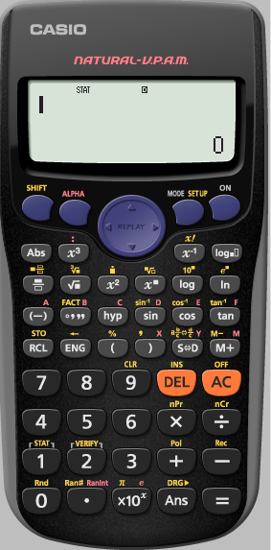
135 145 155 165 175
Height (x cm) | 130 - 140 | 140 – 150 | 150 – 160 | 160 – 170 | 170 – 180
Frequency | 5 | 7 | 8 | 6 | 4
We need to analyse
the STATS we have input
Finding the mean from a frequency table

Slide 26
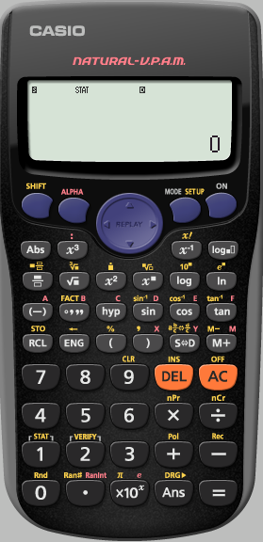
135 145 155 165 175
Height (x cm) | 130 - 140 | 140 – 150 | 150 – 160 | 160 – 170 | 170 – 180
Frequency | 5 | 7 | 8 | 6 | 4
We need to analyse
the STATS we have input

Slide 27
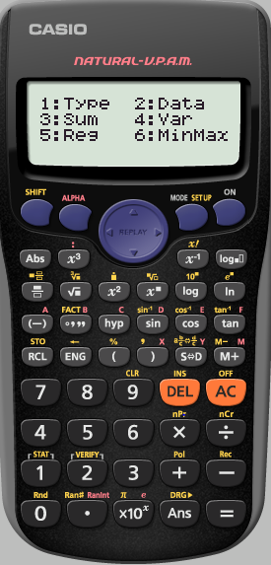
135 145 155 165 175
Height (x cm) | 130 - 140 | 140 – 150 | 150 – 160 | 160 – 170 | 170 – 180
Frequency | 5 | 7 | 8 | 6 | 4
We want use VARiance

Slide 28
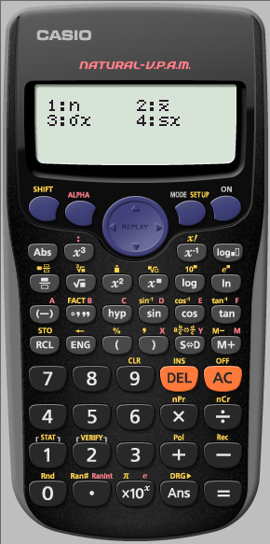
135 145 155 165 175
Height (x cm) | 130 - 140 | 140 – 150 | 150 – 160 | 160 – 170 | 170 – 180
Frequency | 5 | 7 | 8 | 6 | 4
We want to find the mean
$$\overline{x}$$

Slide 29
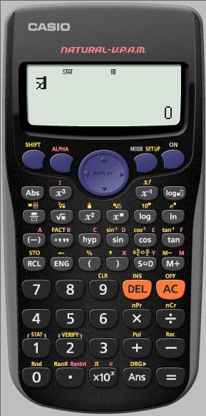
135 145 155 165 175
Height (x cm) | 130 - 140 | 140 – 150 | 150 – 160 | 160 – 170 | 170 – 180
Frequency | 5 | 7 | 8 | 6 | 4
Press
=

Slide 30
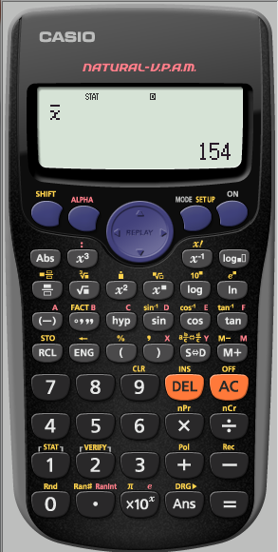
135 145 155 165 175
Height (x cm) | 130 - 140 | 140 – 150 | 150 – 160 | 160 – 170 | 170 – 180
Frequency | 5 | 7 | 8 | 6 | 4
The mean height of
our class is 154cm

